Slide 1
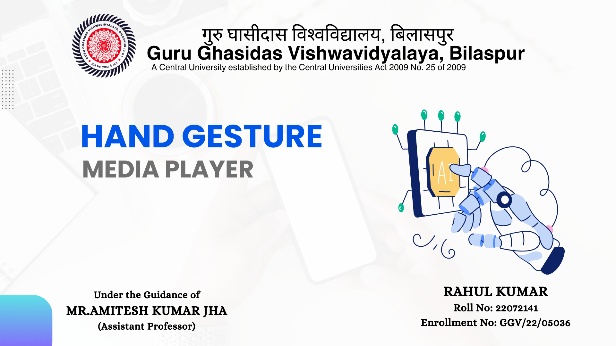

Slide 2
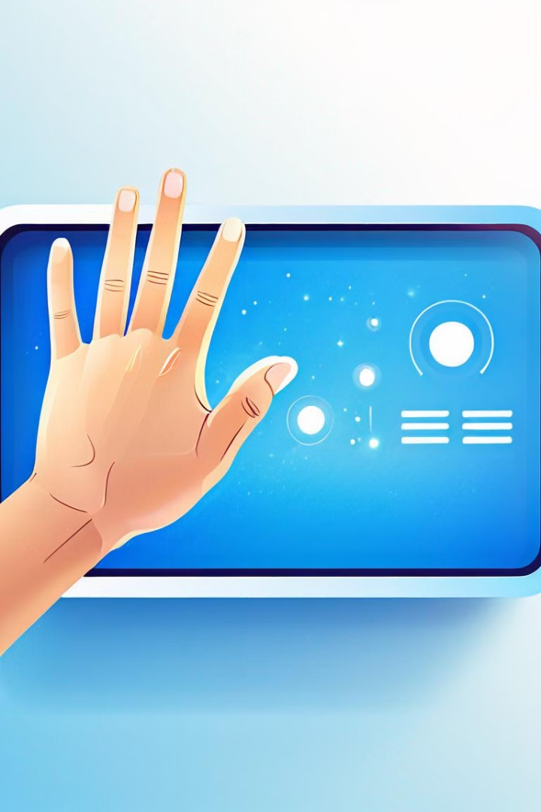
INTRODUCTION
The Hand Gesture Media Player is an innovative solution designed to revolutionize the way users interact with digital media. Instead of relying on traditional input devices like remotes, keyboards, or touchscreens, this media player leverages advanced hand gesture recognition technology to control playback functions. Users can perform simple gestures to play, pause, rewind, fast-forward, or adjust the volume, creating a seamless and intuitive media experience.

Slide 3

m
Problem Statement
Traditional media control methods (remotes, keyboards, touchscreens) are often cumbersome and inconvenient
Remotes can be easily misplaced and require navigating through complex menus.
Touchscreens require physical contact, which can be inconvenient when hands are occupied or dirty.
Limited accessibility for individuals with physical disabilities, making it challenging for them to use these devices effectively.

Slide 4
Objective
The primary objective is to create a user-friendly and intuitive media control system that allows users to manage playback, volume, and other functions through natural hand movements, providing a more immersive and hands-free experience.

Slide 5

Key Components
1
Hand Detection
2
Gesture Recognition
Leverages Mediapipe's advanced hand tracking model to accurately detect and recognize hand landmarks in real-time.
Implements a robust gesture recognition algorithm to interpret user hand movements and translate them into media control commands.
3
Playback Control
Enables seamless control over media playback, including play, pause, volume adjustments, and seeking through the timeline.

Slide 6
Library used
Mediapipe
OpenCV
NumPy
An open-source machine learning framework for building multimodal applied ML pipelines, including hand tracking and gesture recognition.
A popular computer vision library that provides tools for real-time image and video processing, essential for hand detection and gesture analysis.
A powerful numerical computing library in Python, used for efficient data manipulation and processing of hand landmark data.

Slide 7

Hand Detection
The system employs Mediapipe's hand tracking model, which leverages Convolutional Neural Networks (CNNs) to accurately detect and track the key landmarks on the user's hand in real-time. This robust hand detection forms the foundation for the gesture recognition capabilities.

Slide 8

Gesture Recognition
1
Gesture Identification
The system recognizes a set of predefined hand gestures, such as open palm, fist, pinch, and swipe, corresponding to different media control commands.
2
Gesture Classification
Machine learning algorithms, including Support Vector Machines (SVMs) and Random Forests, are used to classify the detected hand gestures and map them to the appropriate media controls.
3
Gesture Tracking
The system continuously tracks the user's hand movements and dynamically updates the media controls, enabling a seamless and responsive hands-free experience.

Slide 9



Playback Control
Play/Pause
Users can start and pause media playback with a simple hand gesture.
Volume Adjustment
Intuitive hand movements allow users to control the volume of the media player.
Seeking
Users can navigate the media timeline and seek to different points in the playback.

Slide 10

User Interface
Minimalist Design
Visual Feedback
The user interface features a clean, modern, and uncluttered design to enhance the focus on hand gestures.
The system provides visual cues and animations to indicate the recognized hand gestures and the corresponding media controls.
Customization
Users can personalize the gesture-to-action mapping and adjust the sensitivity of the hand detection to their preferences.

Slide 11




Future Enhancements
Multi-hand Support
Contextual Awareness
Machine Learning Advancements
Expand the system to recognize and interpret gestures from both hands, unlocking more advanced control options.
Integrate the system with smart home devices and other applications, enabling seamless hands-free control across various domains.
Leverage the latest advancements in deep learning and computer vision to enhance the accuracy and responsiveness of the gesture recognition.

Slide 12

Limitations
Environmental Factors
The system's performance may be affected by lighting conditions, camera angles, and other environmental variables.
Gesture Complexity
While the current gesture set is intuitive, more complex or subtle hand movements may be challenging to reliably detect and interpret.
Robustness
Continued refinement of the machine learning models and algorithms is necessary to ensure consistent and reliable hands-free media control.

